Slide 1
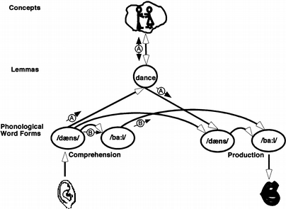
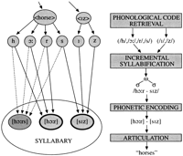
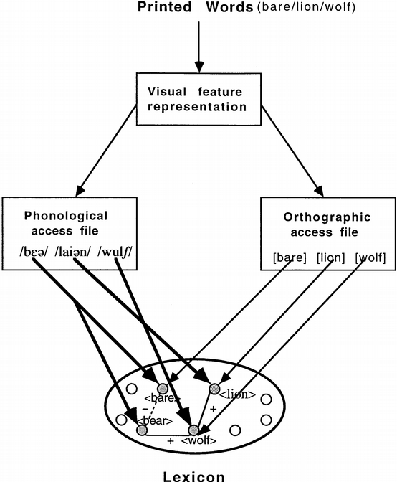
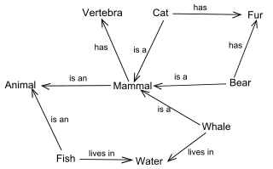
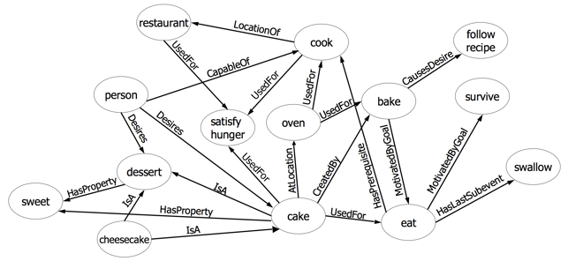
PSY 480.24: Psycholinguistics
Introductions & crash course in
Traditional Psycholinguistics

Slide 2
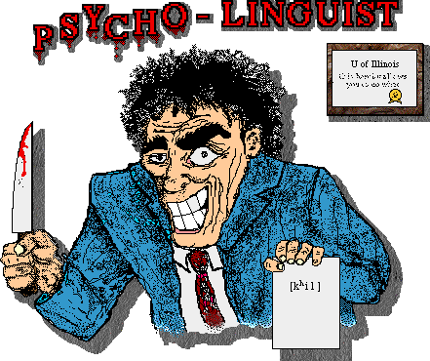
What is “psycholinguistics”?

Slide 3
What is “psycholinguistics”?
Psycho
Linguistics
The study of language
from a psychological perspective.

Slide 4
What is “psycholinguistics”?
Psycho
Linguistics
Mental Processes
Short Term Memory
Long Term Memory
Encoding
Retrieval
Mental Representations
Linguistic Theory
Phonology
Morphology
Syntax
Semantics
- Rules

Slide 5
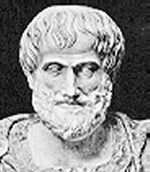
Psycholinguistics : A brief history
1900
10
20
50
60
70
80
90
2000
Pre-psycholinguistics:
The ancient Greeks:
Noticed that brain damage could cause aphasia
Aristotle: objects of the world exist
independent of language and that definite
words are subsequently allied to these objects
Notes:
Plato too

Slide 6
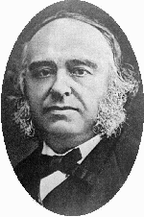
Psycholinguistics : A brief history
1900
10
20
50
60
70
80
90
2000
Pre-psycholinguistics:
Paul Broca (1861):
described a patient who could say only one
word..."tan."
damage to part of the left frontal cortex
("Broca's Area”)

Slide 7
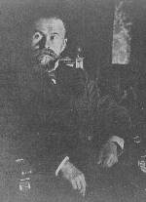
Psycholinguistics : A brief history
1900
10
20
50
60
70
80
90
2000
Pre-psycholinguistics:
Karl Wernicke (1876):
Found that damage to posterior part of the
temporal lobe caused a different kind of
language problems.
Wernicke's Area

Slide 8
Psycholinguistics : A brief history
1900
10
20
50
60
70
80
90
2000
Pre-psycholinguistics (1800s):
Philosophers of Language:
Wittgenstein: underlying logic of language
Russell: reference and language universals
Frege: sense and reference (meaning)

Slide 9
Psycholinguistics : A brief history
psycINFO
16
Pre 1920
1900
10
20
50
60
70
80
90
2000
Pre-psycholinguistics:
Merringer & Meyer (1895):
Speech errors reveal properties of linguistic
system

Slide 10
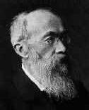
Psycholinguistics : A brief history
psycINFO
16
Pre 1920
1900
10
20
50
60
70
80
90
2000
Pre-psycholinguistics:
Wilhelm Wundt:
Physiologist
Established the first psychological laboratory
Wrote about language
Early theory of language production
Notes:
Wundt suggesteed that the fundamental unit of language is the sentence -- not the word or the sound. He identified the sentence not just with a sequence of words and sounds, but as a special mental state. Sounds, words, the rules of grammer, etc., all have their meaning only in relation to that underlying mental sentence.
Wundt actually invented the tree diagram of syntax we are all familiar with in linguistics texts! Language starts with S (the sentence) at the top, and selective attention separates the subject (the focus or figure) from the predicate (the ground), and so on, in contrast to the popular bottom-up, associationistic conception the behaviorists proposed. Wundt's ideas are now the standard -- yet no one remembers they were his in the first place!
language processes = mental processes

Slide 11
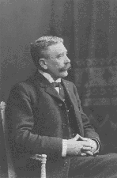
Psycholinguistics : A brief history
psycINFO
16
Pre 1920
1900
10
20
50
60
70
80
90
2000
Pre-psycholinguistics:
Ferdinand de Saussure:
Linguist
Separation of historical linguistics and
descriptive linguistics
Notes:
Historical linguistics - comparing languages (primarily IndoEuropean languages) and discovering the principles guiding the changes undergone by the languages
had been the dominant
Descriptive linguistics - describing a language as a whole at a particular point in time

Slide 12
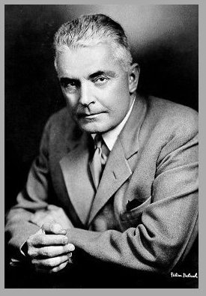
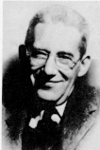
Psycholinguistics : A brief history
psycINFO
3990
1920-50
1900
10
20
50
60
70
80
90
2000
Pre-psycholinguistics:
From the 1920’s to the mid 1950’s Psychology was
dominated by behaviorism
John B. Watson (1920): Is thinking merely the
action of language mechanisms?
Leonard Bloomfield (1935): Language
Notes:
Viewed language as systems of stimulus-response patterns (kind of verbal habits), built up through conditioning
Focus of the behaviorist tradition is to only make theories about observable behaviors (basic argument: mental processes aren’t directly observable, so they aren’t testable, so they don’t belong in theories)

Slide 13
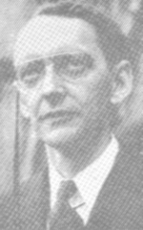
Psycholinguistics : A brief history
psycINFO
2911
1951-60
1900
10
20
50
60
70
80
90
2000
Dawn of psycholinguistics (50s):
Lashley (1951):
Neuropsychologist
Argued that the structure of a sentences must
be more than just associations between
adjacent words

Slide 14
Psycholinguistics : A brief history
psycINFO
2911
1951-60
1900
10
20
50
60
70
80
90
2000
Dawn of psycholinguistics (50s):
1951: Social Science Research Council
Conference which invited many of the most
prominent psychologists and linguists
Often identified as the “birth” of
psycholinguistics

Slide 15
Psycholinguistics : A brief history
psycINFO
2911
1951-60
1900
10
20
50
60
70
80
90
2000
Dawn of psycholinguistics (50s):
1953: Another conference
Included psychologists, linguists,
anthropologists, and communication engineers
First time the term psycholinguistics is used
‘Birth’ of Cognitive Science
Notes:
Cognitive Science - a multi-disciplinary field to investigate the mind/brain

Slide 16
Psycholinguistics : A brief history
psycINFO
2911
1951-60
1900
10
20
50
60
70
80
90
2000
Dawn of psycholinguistics (50s):
Defense department funds projects:
Machine translators
Machine speech processors
The beginnings of the field of artificial
intelligence research

Slide 17
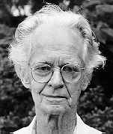
Psycholinguistics : A brief history
psycINFO
2911
1951-60
1900
10
20
50
60
70
80
90
2000
Dawn of psycholinguistics (50s):
B. F. Skinner (1957):
Behavioral psychologist
Published Verbal Behavior
In-depth analysis of language within the
behavioral framework

Slide 18
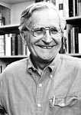
Psycholinguistics : A brief history
psycINFO
2911
1951-60
1900
10
20
50
60
70
80
90
2000
Dawn of psycholinguistics (50s):
Noam Chomsky :
Linguist
(1957) published Syntactic Structures
(1959) book review of Verbal Behavior
Notes:
Among the arguments, perhaps the most famous is his example:
“colorless green ideas sleep furiously”
Even though the associations between these words are virtually absent, the sentence is recognized as syntactically correct.
In contrast
“furiously sleep ideas green colorless” is recognized as ungrammatical.

Slide 19
Chomskyan revolution
Major proposals/innovations
Develop a grammar that can generate an infinite number of grammatical sentences
Transformational-generative grammar
Language acquisition - innate universal grammar
Limited explicit instruction for language learners
Arguments against behaviorist accounts of language
Often credited with the downfall of behaviorism

Slide 20
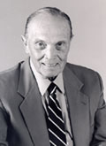
Psycholinguistics : A brief history
psycINFO
4221
1961-70
1900
10
20
50
60
70
80
90
2000
Psycholinguistics (60s):
George Miller
Cognitive psychologist
Collaborated with Chomsky
Beginnings of the search for the psychological
reality of linguistic rules

Slide 21
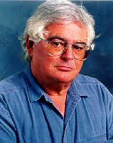
Psycholinguistics : A brief history
psycINFO
4221
1961-70
1900
10
20
50
60
70
80
90
2000
Psycholinguistics (60s):
The search for psychological reality of
syntactic transformations begins
e.g., studies by Bever, Fodor, and Garrett

Slide 22
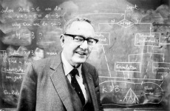
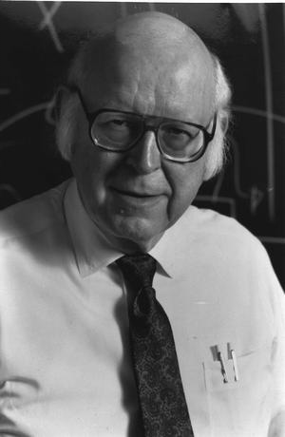
Psycholinguistics : A brief history
psycINFO
8137
1971-80
1900
10
20
50
60
70
80
90
2000
Artificial intelligence (60s & 70s):
Computer theory began to have an impact:
Newell & Simon: computers are symbol manipulators,
information processing approach
Collins & Quillian: natural language processing requires an
explicit representation of conceptual knowledge
Networks of proposition & spreading activation

Slide 23
Psycholinguistics : A brief history
psycINFO
8137
1971-80
1900
10
20
50
60
70
80
90
2000
Psycholinguistics (70s):
Psycholinguistic research begins to drift away from linguistics:
Mounting evidence against psychological reality of
transformation
New competing linguistic theories (e.g., generative semantics)
and rapid change to existing theories

Slide 24
Psycholinguistics : A brief history
psycINFO
8137
1971-80
1900
10
20
50
60
70
80
90
2000
Psycholinguistics (mid70s):
Psycholinguistics without linguistics:
Began to shift focus away from syntax
Higher levels of comprehension (e.g., meaning and
discourse)
Lower levels: word recognition and sub-lexical perception

Slide 25
Psycholinguistics : A brief history
psycINFO
16,838
1981-90
1900
10
20
50
60
70
80
90
2000
Psycholinguistics (80s):
Psycholinguistics further splits:
More drifting away from linguistic, focusing on cognitive psychology (i.e. incorporation of more information processing ideas)
Splits within psycholinguistics: experimental psycholinguistics and developmental psycholinguistics

Slide 26
Psycholinguistics : A brief history
psycINFO
16,838
1981-90
1900
10
20
50
60
70
80
90
2000
Psycholinguistics (mid to late 80s):
Rise of connectionism:
Neural network models are (re-?)introduced to psychological
theory, including models of language
Attracts a lot of excitement and debate

Slide 27
Psycholinguistics : A brief history
psycINFO
36,758
1990-now
1900
10
20
50
60
70
80
90
2000
Psycholinguistics (90s & today):
Cognitive Science starts to re-unify linguistics and psycholinguistics
(& neuropsychology, philosophy, anthropology, computer science)
Linguists begin paying attention to psycholinguistic findings
Psycholinguists start using linguistic theory again
Notes:
By mid 90s there are over 200 Cognitive Science programs around the world
Brought together, within the same departments, linguists, psychologists, neurobiologists, philosophers, etc.
This has led to more collaborative work within psycholinguistics

Slide 28
Psycholinguistics
A multidisciplinary field
Psychology
Linguistics
Computer science
Neuropsychology
Philosophy
Anthropology
And more
Notes:
Psycholinguistics is influenced by research in linguistics,sociolinguistics, philosophy, anthropology and ethology,
neuroscience, computer science and speech technology, speech pathology, and communication studies.
Linguistics: linguists and psycholinguists are interested in common issues such as how do we parse sentence?, how do we recognize words?
Philosophy: interested in the philosophy of language such as the nature of meaning and reference, rational thinking, learning, reasoning, logic etc.
Computer science and speech technology: includes several disciplines that use computers, computer technology and
computer software to discover what language is and does.
Neuroscience: is multidisciplinary science of the nervous system including medicine, psychology, psychiatry, biology, and brain imaging. It studies neurological aspects of language including language/speech anatomy, physiology, genetics, synaptic transmission, brain and nervous system, and brain and brain imaging technology.
Anthropology and Ethology: interested in the structural components of languages, how culture constructs its view of the world through language. Ethologists study nonhuman animal in natural setting and make a comparison between human and nonhuman communication capacities.
Sociolinguists focuses on the effects social contexts on language use, e.g., how speech production is affected by class, race, gender, education, social status, social setting etc.
Speech and hearing disorders: speech disorder specialists work with people who manifest deficits or delays in comprehension or production in comparison to normal language users.
Standardized tests are used to examine which aspects of language development are related to general cognitive development and which are uniquely linguistic.
Communication studies: examine social and political implication of human language use. They study how a speaker’s effectiveness or persuasiveness on an audience is affected by the use of humor, how political forces in a culture shape word meanings and conceptual reasoning.

Slide 29
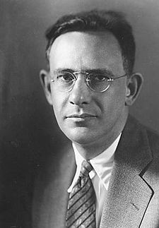
What is language?
A difficult question to answer:
“Language is a purely human and non-instinctive method of communicating ideas, emotions and desires by means of voluntrily produced symbols.”
Edward Sapir (1921)

Slide 30
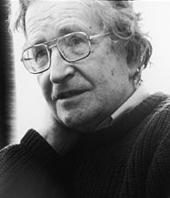
What is language?
A difficult question to answer:
“A language is a set (finite or infinite) of sentences, each finite in length and constructed out of a finite set of elements.”
Noam Chomsky (1957)

Slide 31
What is language?
Some generally agreed upon conclusions
Symbolic (representational)
Elements are used to represent something other than itself
Voluntary
Language use is under our individual control
Modalities
Spoken, written, signed (sign language)
Assumed primacy of speech - it came first
Language is systematic
There is hierarchical structure that organizes linguistic elements

Slide 32
Psycholinguistics
“Psycholinguistics turns out to be the study of the mental representations and processes that are involved when one uses a particular language phenomenon while being engaged in a particular language skill… what exactly is meant by a mental representation and a mental process?”
Sandra (2009) pg 293
Notes:
Psycholinguistics is influenced by research in linguistics,sociolinguistics, philosophy, anthropology and ethology,
neuroscience, computer science and speech technology, speech pathology, and communication studies.
Linguistics: linguists and psycholinguists are interested in common issues such as how do we parse sentence?, how do we recognize words?
Philosophy: interested in the philosophy of language such as the nature of meaning and reference, rational thinking, learning, reasoning, logic etc.
Computer science and speech technology: includes several disciplines that use computers, computer technology and
computer software to discover what language is and does.
Neuroscience: is multidisciplinary science of the nervous system including medicine, psychology, psychiatry, biology, and brain imaging. It studies neurological aspects of language including language/speech anatomy, physiology, genetics, synaptic transmission, brain and nervous system, and brain and brain imaging technology.
Anthropology and Ethology: interested in the structural components of languages, how culture constructs its view of the world through language. Ethologists study nonhuman animal in natural setting and make a comparison between human and nonhuman communication capacities.
Sociolinguists focuses on the effects social contexts on language use, e.g., how speech production is affected by class, race, gender, education, social status, social setting etc.
Speech and hearing disorders: speech disorder specialists work with people who manifest deficits or delays in comprehension or production in comparison to normal language users.
Standardized tests are used to examine which aspects of language development are related to general cognitive development and which are uniquely linguistic.
Communication studies: examine social and political implication of human language use. They study how a speaker’s effectiveness or persuasiveness on an audience is affected by the use of humor, how political forces in a culture shape word meanings and conceptual reasoning.

Slide 33
Mental Representations
“Representation – presenting something again in a different form (breaking the word down morphologically). Think about how music may be represented in multiple ways: notes on paper, groves on a vinyl record, pits and lands on a CD (which in turn represent 0’s and 1’s of a digital code).”
“Mental representations are similar – they represent information that has to be store both in a particular code in a particular medium (formed by the structures of the brain). The code(s) of psycholinguistics are scientific constructs, forming an interface between the physical realization of language and its encoding in the brain. These scientific constructs often borrow terms and distinctions theorized in linguistics.”
From the Sandra (2009) chapter
Notes:
Psycholinguistics is influenced by research in linguistics,sociolinguistics, philosophy, anthropology and ethology,
neuroscience, computer science and speech technology, speech pathology, and communication studies.
Linguistics: linguists and psycholinguists are interested in common issues such as how do we parse sentence?, how do we recognize words?
Philosophy: interested in the philosophy of language such as the nature of meaning and reference, rational thinking, learning, reasoning, logic etc.
Computer science and speech technology: includes several disciplines that use computers, computer technology and
computer software to discover what language is and does.
Neuroscience: is multidisciplinary science of the nervous system including medicine, psychology, psychiatry, biology, and brain imaging. It studies neurological aspects of language including language/speech anatomy, physiology, genetics, synaptic transmission, brain and nervous system, and brain and brain imaging technology.
Anthropology and Ethology: interested in the structural components of languages, how culture constructs its view of the world through language. Ethologists study nonhuman animal in natural setting and make a comparison between human and nonhuman communication capacities.
Sociolinguists focuses on the effects social contexts on language use, e.g., how speech production is affected by class, race, gender, education, social status, social setting etc.
Speech and hearing disorders: speech disorder specialists work with people who manifest deficits or delays in comprehension or production in comparison to normal language users.
Standardized tests are used to examine which aspects of language development are related to general cognitive development and which are uniquely linguistic.
Communication studies: examine social and political implication of human language use. They study how a speaker’s effectiveness or persuasiveness on an audience is affected by the use of humor, how political forces in a culture shape word meanings and conceptual reasoning.

Slide 34
Mental Processes
“Mental processes are operations on mental representations (ultimately translated into brain processes). “Many psycholinguists conceive of a mental process as a procedure that maps one type of mental representation onto a different one.” pg 295
From the Sandra (2009) chapter
Notes:
Psycholinguistics is influenced by research in linguistics,sociolinguistics, philosophy, anthropology and ethology,
neuroscience, computer science and speech technology, speech pathology, and communication studies.
Linguistics: linguists and psycholinguists are interested in common issues such as how do we parse sentence?, how do we recognize words?
Philosophy: interested in the philosophy of language such as the nature of meaning and reference, rational thinking, learning, reasoning, logic etc.
Computer science and speech technology: includes several disciplines that use computers, computer technology and
computer software to discover what language is and does.
Neuroscience: is multidisciplinary science of the nervous system including medicine, psychology, psychiatry, biology, and brain imaging. It studies neurological aspects of language including language/speech anatomy, physiology, genetics, synaptic transmission, brain and nervous system, and brain and brain imaging technology.
Anthropology and Ethology: interested in the structural components of languages, how culture constructs its view of the world through language. Ethologists study nonhuman animal in natural setting and make a comparison between human and nonhuman communication capacities.
Sociolinguists focuses on the effects social contexts on language use, e.g., how speech production is affected by class, race, gender, education, social status, social setting etc.
Speech and hearing disorders: speech disorder specialists work with people who manifest deficits or delays in comprehension or production in comparison to normal language users.
Standardized tests are used to examine which aspects of language development are related to general cognitive development and which are uniquely linguistic.
Communication studies: examine social and political implication of human language use. They study how a speaker’s effectiveness or persuasiveness on an audience is affected by the use of humor, how political forces in a culture shape word meanings and conceptual reasoning.

Slide 35
Hello there!
Multiple levels of analysis
Word order important (don’t say “There Hello!”)
Each word composed of a sequence of sounds
Sentence is uttered in a particular tone of voice (signified by the “!”, rather than a “Hello there?”)
Used to signal particular part of a social interaction (would say it at the beginning of the interaction, not when leaving or in the middle)

Slide 36
Levels of analysis
Phonology
Morphology
Syntax
Semantics
Pragmatics
language
structure
pragmatics
use
medium of
transmission
grammar
meaning
(semantics)
phonetics
phonology
morphology
syntax
lexicon
discourse

Slide 37
Levels of analysis
Phonology
Morphology
Syntax
Semantics
Pragmatics
language
structure
pragmatics
use
medium of
transmission
grammar
meaning
(semantics)
phonetics
phonology
morphology
syntax
lexicon
discourse

Slide 38
Phonology
The sounds of a language
Phonemes, allophones & phones
Phonemes - abstract (mental) representations of the sound units in a language
Rules about how to put the sounds together
Includes sound structures like syllables, onsets, rhymes
Notes:
http://en.wikipedia.org/wiki/Phoneme

Slide 39
Phonology
allophones
phonemes
pill
[p^{h}]
Listen to the ‘p’ sound
/p/
spill
[p]
Rule: If /p/ is used in word initial position you add aspiration (a puff of air), if word internal don’t aspirate

Slide 40
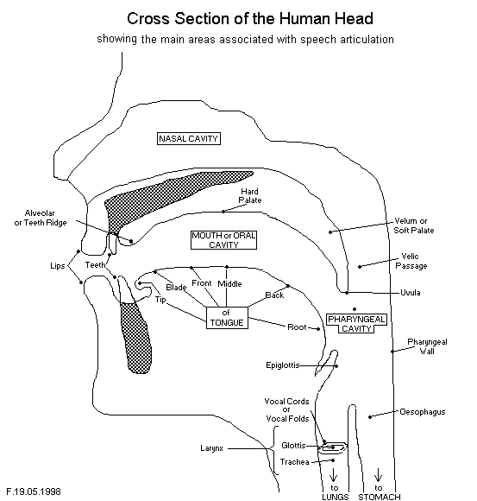
Articulatory features
Point of articulation
Six major points:
Larynx, soft palate, tongue body, tongue tip,tongue root, lips
Manner
How the articulator
moves: nasality,
aspiration, etc.
Configuration of other
organs
Voiced, rounded, etc.
Notes:
For voicing have the students compare ‘ssssssss’ with ‘zzzzzzzz’

Slide 41
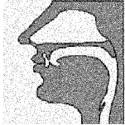
Phonology
+ voice
- voice
/b/
/p/
bilabial
/d/
/t/
alveolar
see mixed features
Notes:
http://www.speechandhearing.net/laboratory/demos.html

Slide 42
Phonemes
Languages differ in two ways (with respect to phonology)
the set of segments that they employ.
English has about 40 phonemes
Polynesian has ~11 Hawaiian
Khoisan (‘Bushman’) has ~141listen to clicks
- the set of phonological rules

Slide 43
Phonological Rules
Some non-words are “legal” and some are not
“spink” is okay
“ptink” isn’t
(but notice that apt is, as is captain)
In English the segment /pt/ isn’t acceptable
in the word initial position

Slide 44
Psychological reality of phonemes
Miller & Nicely (1955)
Participants were presented phonemes embedded in white noise.
When they made mistakes, confusions between phonemes which varied by one feature were more common than those that varied by two features
/b/
/p/
/d/
/t/

Slide 45
Psychological reality of phonemes
Liberman et al (1957) categorical perception of phonemes
Presented consonant-vowel syllables along a continuum
The consonants were /b/, /d/, and /g/, followed by /a/
for example, /ba/.
Asked whether two syllables were the same or different
Participants reported
Various forms of /ba/ to be the same
Whereas /ga/ and /ba/ were easily discriminated.

Slide 46
Levels of analysis
Phonology
Morphology
Syntax
Semantics
Pragmatics
language
structure
pragmatics
use
medium of
transmission
grammar
meaning
(semantics)
phonetics
phonology
morphology
syntax
lexicon
discourse

Slide 47
Morphology
Morpheme – smallest unit that conveys meaning
no internal morphological structure
/y/, /e/, /s/ none have meaning in isolation
yes
happy, horse, talk
un- negative
-ness state/quality
-s plural
-ing duration
unhappiness
horses
talking
un- -happi- -ness
horse- -s
talk- -ing
Notes:
What’s a word?
Five tests of word identification:
Potential pause: say a sentence slowly, pauses often will fall between words (but not always, and pauses also show up between syllables within words)
Indivisibility: try to add extra words to a sentence. The extra words will fall between, but not within words.
Minimal free forms: The smallest units that can meaningfully stand on their own.
Phonetic boundaries: sometimes stress patterns can indicate where a word begins or ends
Semantic units: look for the units that carry meaning (e.g., Dog bites man. Clearly has 3 units of meaning)

Slide 48
Morphology
Morpheme Productivity
Free morphemes: can stand alone as words
Bound morphemes: can not stand alone as words
Affixes, pre-fixes, suffixes, infixes
Inflectional rules
used to express grammatical contrasts in sentences
e.g., singular/plural, past/present tense
Derivational rules
Construction of new words, or change grammatical class
e.g., drink --> drinkable, infect --> disinfect

Slide 49
Phonology & morphology interaction
Allomorphs: different variations of the same morpheme
Plural rule in English
The plural morpheme takes the form:
/-iz/ If the last sound in a noun is a sibilant consonant
“churches”
/-z/ if the last sound in a noun is voiced
“labs”
/-s/ if the last sound in a noun is voiceless
“bets”

Slide 50
Morphology
Language differences
Isolating languages: no endings, just word order (e.g., Chinese & Vietnamese)
Inflecting: lots of inflections (e.g., Latin & Greek)
In Classic Greek every verb has 350 forms
Agglutinating languages (e.g., Turkish, Finnish, Eskimo)
Eskimo:
angyaghllangyugtuq = he wants to acquire a big boat
Angya- ‘boat’; -ghlla- ‘augmentative meaning’; -ng- ‘acquire’; -yug- ‘expresses desire’; -tuq- third person singular
Notes:
Languages don’t fit perfectly into these categories.
English is probably best put in the Isolating language category.
Yes we have inflections, but not many.
Nouns:2 - Boy and Boys
Verbs: 4 - Walk, walks, walked, walking

Slide 51
Psychological reality of Morphology
Speech errors
Stranding errors: The free morpheme typically moves, but the bound morpheme stays in the same location
they are Turking talkish (talking Turkish)
you have to square it facely (face it squarely)
Morpheme substitutions
a timeful remark (timely)
Where's the fire distinguisher? (Where's the fire extinguisher?)
Morpheme shift
I haven't satten down and writ__ it (I haven't sat down and written it)
what that add__ ups to (adds up to)

Slide 52
Psychological reality of Morphology
Wug test (Gleason, 1958)
Here is a wug.
Now there are two of them.
There are two _______.

Slide 53
Levels of analysis
Phonology
Morphology
Syntax
Semantics
Pragmatics
language
structure
pragmatics
use
medium of
transmission
grammar
meaning
(semantics)
phonetics
phonology
morphology
syntax
lexicon
discourse

Slide 54
Syntax: the ordering of the words
A dog bites a man.

Slide 55
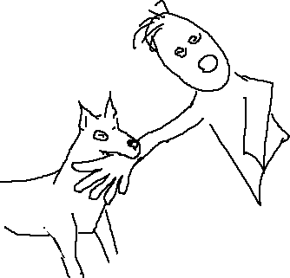
Syntax: the ordering of the words
A dog bites a man.
A man bites a dog.
Same words, but different word order leads to a radically different interpretation

Slide 56
Syntax: the ordering of the words
A dog bites a man.
A man bites a dog.
A dog was bitten by a man.
Not just the linear ordering
It is the underlying set of syntactic rules

Slide 57
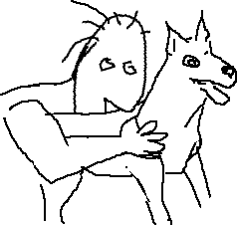
Syntax: the ordering of the words
The underlying structural position, rather than surface linear position matters.

Slide 58
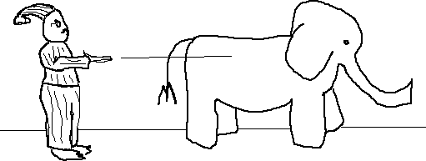
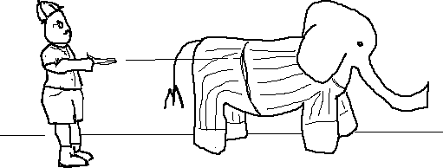
Syntactic Ambiguity (wiki)
The same linear order (surface structure) may be ambiguous with respect to the underlying structure
Groucho Marx shot an elephant in his pajamas
Good shot
How he got into my pajamas
I’ll never know

Slide 59
Syntactic Ambiguity

Slide 60
Generative Grammar (wiki)
The pieces:
Grammatical features of words
Dog: Noun
Bite: Verb
Phrase structure rules - these tell us how to build legal structures
S --> NP VP
(a sentence consists of a noun phrase followed by a verb phrase)
VP --> V (NP)
NP --> (A) (ADJ) N

Slide 61
Generative Grammar
Recursion: you can embed structures within structures
NP --> (A) (ADJ) N (PP)
PP --> Prep NP
So we NP’s can be embedded within PP’s which in turn may be embedded within NP’s.
The dog with the bone of the dinosaur from the cave with the paintings of the animals with fur bit the man.
The result is an infinite number of syntactic structures from a finite set of pieces

Slide 62
Psychological reality of syntax
Derivational theory of complexity
The more transformations, the more complex
The boy was bitten by the wolf
The boy was bitten. (involves deletion)
No evidence for more processing of the second sentence

Slide 63
Psychological reality of syntax
Derivational theory of complexity
The more transformations, the more complex
The boy was bitten by the wolf
The boy was bitten. (involves deletion)
No evidence for more processing of the second sentence
Evidence for (trace)
Some recent evidence or reactivation of moved constituent at the trace position

Slide 64
Transformational grammar
Deep structure
Surface structure
S
S
NP
VP
NP
VP
The car
VP
NP
PP
VP
NP
PP
was put
the car
in the garage
was put
(trace)
in the garage
probe
Some “activation” of car
Movement transformation

Slide 65
Levels of analysis
Phonology
Morphology
Syntax
Semantics
Pragmatics
language
structure
pragmatics
use
medium of
transmission
grammar
meaning
(semantics)
phonetics
phonology
morphology
syntax
lexicon
discourse

Slide 66
Semantics
The study of meaning
Arbitrariness
“What’s in a name? that which we call a rose
By any other name would smell as sweet.”
Words are not the same as meaning
Words are symbols linked to mental representations of meaning (concepts)
Even if we changed the name of a rose, we wouldn’t change the concept of what a rose is

Slide 67
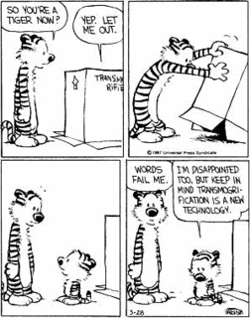
Separation of word and meaning
Concepts and words are different things
Translation argument
Every language has words without meaning, and meanings without words
e.g., transmogrify, wheedle, scalawag
Imperfect mapping
Multiple meanings of words
e.g., ball, bank, bear
Elasticity of meaning
Meanings of words can change with context
e.g., newspaper
Notes:
Words are not the same as meaning
Translation argument
e.g., recognizing a word, but not really knowing what it means -
transmogrify - to change or alter greatly and often with grotesque or humorous effect
wheedle - to influence or entice by soft words or flattery
scalawag - a white Southerner acting in support of the reconstruction governments after
the American Civil War often for private gain
recognizing a concept without knowing the word for it end of shoelace - “aglet”
Imperfect mapping
e.g., homophones like ball, bank
Elasticity of meaning
e.g., newspaper - the thing you read, the company you work for, the building they are printed in, the thing you put in the hamster cage

Slide 68
Semantics
Philosophy of meaning
Sense and reference
“The world’s most famous athlete.”
“The athlete making the most endorsement income.”
2 distinct senses, 1 reference
Over time the senses typically stay the same, while the references may change
Now
In the 90’s

Slide 69
Semantics
Two levels of analysis (and two traditions of psycholinguistic research)
Word level (lexical semantics)
How do we store words?
How are they organized?
What is meaning?
How do words relate to meaning?
Sentence level (compositional semantics)
How do we construct higher order meaning?
How do word meanings and syntax interact?

Slide 70
Lexical Semantics
Word level
The (mental) lexicon: the words we know
The average person knows ~60,000 words
How are these words represented and organized?
Dictionary definitions?
Necessary and sufficient features?
Lists of features?
Networks?

Slide 71
Word and their meanings
“John is a bachelor.”
What does bachelor mean?
What if John:
is married?
is divorced?
has lived with the mother of his children for 10 years but they aren’t married?
has lived with his partner Joe for 10 years?
Notes:
Demonstrates that probably no set of necessary and sufficient features

Slide 72
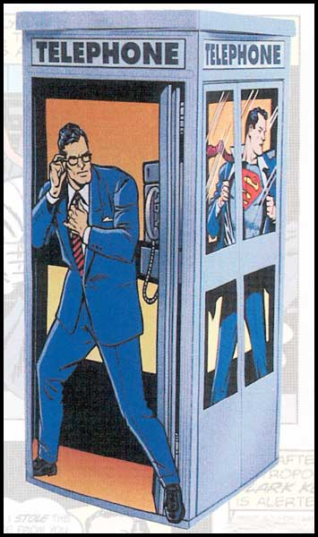
Lexical Ambiguity
What happens when we use ambiguous words in our utterances?
“Oh no, Lois has been
hypnotized and is jumping
off the bank!”

Slide 73
Money “bank”
River “bank”

Slide 74
Lexical Ambiguity
Psycholinguistic evidence suggests that multiple meanings are considered
Debate: how do we decide which meaning is correct
Based on: frequency, context
Hmm… ‘bank’ usually means
the financial institution, but
Lois was going fishing with
Jimmy today …

Slide 75
Compositional Semantics
Phrase and sentence level
Some of the theories
Truth conditional semantics: meaning is a logical relationship between an utterance and a state of affairs in the world
Proposition:
A relationship between two (or more) concepts
Has a truth value
Jackendoff’s semantics
Concepts are lists of features, images, and procedural knowledge
Conceptual formation rules
Cognitive grammar
Mental models - mental simulations of the world

Slide 76
Levels of analysis
Phonology
Morphology
Syntax
Semantics
Pragmatics
language
structure
pragmatics
use
medium of
transmission
grammar
meaning
(semantics)
phonetics
phonology
morphology
syntax
lexicon
discourse

Slide 77
Pragmatics
Sentences do more than just state facts, instead they are uttered to perform actions
How to do things with words (J. L. Austin, 1955 lectures)
Using registers
Conversational implicatures
Speech acts

Slide 78
Pragmatics
Registers: How we modify conversation when addressing different listeners
Determine our choice of wording or interpretation based on different contexts and situations
Speech directed at babies, at friends, at bosses, at foreigners

Slide 79
Pragmatics
Conversational implicatures
Speakers are cooperative
Grice’s conversational maxims
Quantity: say only as much as is needed
Quality: say only what you know is true
Relation: say only relevant things
Manner: Avoid ambiguity, be as clear as possible

Slide 80
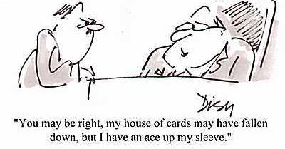
Pragmatics
Speech acts: How language is used to accomplish various ends
Direct speech acts
Open the window please.
Clean up your room!
Indirect speech acts
“It is hot in here”
“Your room is a complete mess!”
Non-literal language use
e.g., Metaphors and idioms

Slide 81
Language is complex
Even though it feels simple to produce and understand language, it is a very complex behavior
language
structure
pragmatics
use
medium of
transmission
grammar
meaning
(semantics)
phonetics
phonology
morphology
syntax
lexicon
discourse

Slide 82
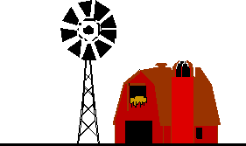

Slide 83
Some of the big questions
Comprehension
Production
Representation
How do we store linguistic information?
How do we retrieve that information?

Slide 84
Some of the big questions
How do we turn our thoughts into a spoken or written output?
Production
“the horse raced past the barn”

Slide 85
A model of sentence production
Three broad stages:
Conceptualisation
deciding on the message (= meaning to express)
Formulation
turning the message into linguistic representations
Grammatical encoding (finding words and putting them together)
Phonological encoding (finding sounds and putting them together)
Articulation
speaking (or writing or signing)

Slide 86
Some of the big questions
How do we understand language that we hear/see?
Comprehension
“the horse raced past the barn”

Slide 87
Conceptualizer
Thought
Semantic
Analysis
Formulator
Grammatical Encoding
Syntactic
Analysis
Lexicon
Phonological Encoding
Word
Recognition
Articulator
Letter/phoneme
Recognition

Slide 88
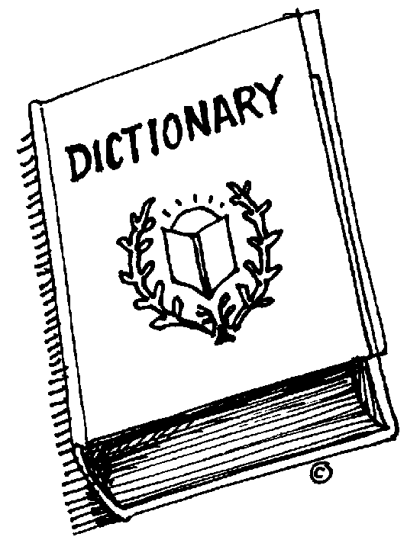
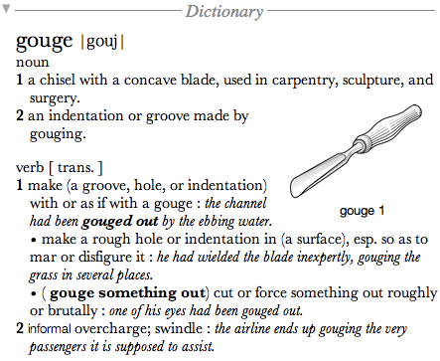
Storing linguistic information
Tale of the tape:
High capacity: 40,000 – 60,000 words
Fast: Recognition in as little as 200ms (often before word ends)
How do we search that many, that fast!? – suggests that there is a high amount of organization
Or something much more complex
“The world’s largest data bank of examples in context is dwarfed by the collection we all carry around subconsciously in our heads.”
E. Lenneberg (1967)
Excellent reading: Words in the Mind, Aitchison (1987, 2003)

Slide 89
Storing linguistic information
Interesting questions:
How are words stored?
What are they made up of?
How are words related to each other?
How do we use them?
Some vocabulary
Mental lexicon The representation of words in long term memory
Lexical Access: How do we activate (retrieve) words and their the meanings (and other properties)?

Slide 90
Theoretical Metaphors: Access vs. retrieval
Often used interchangeably, but sometimes a distinction is made
Activate - finding the representation
Retrieval - getting information from the representation
Here it is

Slide 91
Theoretical Metaphors: Access vs. retrieval
Often used interchangeably, but sometimes a distinction is made
Activate - finding the representation
Retrieval - getting information from the representation
Open it up and see what’s inside

Slide 92
Lexical primitives
Word primitives
horse
horses
barn
barns
Need a lot of representations
Fast retrieval
Morpheme primitives
horse
-s
barn
Economical - fewer representations
Slow retrieval - some assembly required
Decomposition during comprehension
Composition during production

Slide 93
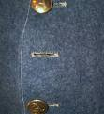
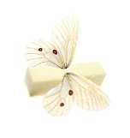
Lexical primitives
May depend on other factors
What kind of morpheme
Inflectional (e.g., singular/plural, past/present tense)
Derivational (e.g., drink --> drinkable, infect --> disinfect)
Frequency of usage
High frequency multimorphemic (in particular if derivational morphology) may get represented as a single unit
e.g., impossible vs. imperceptible
Compound words
Semantically transparent
Buttonhole
Semantically opaque
butterfly
Notes:
Try to strike a balance between cognitive economy of number of representations and how much assembling needs to be done

Slide 94
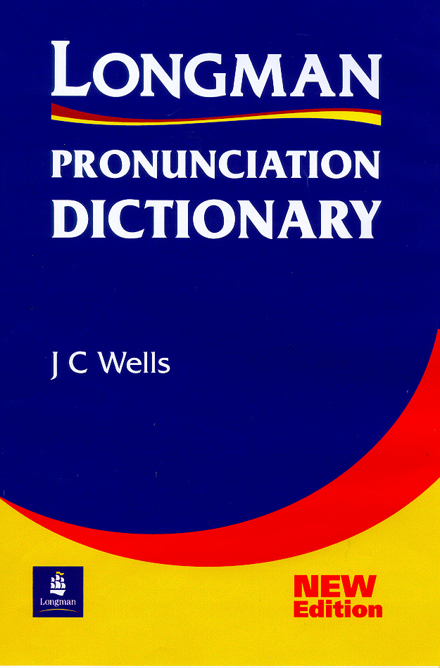
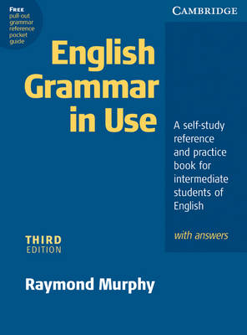
Lexical organization
How are the lexical representations organized?
Alphabetically?
Initial phoneme?
Semantic categories?
Grammatical class?
Something more flexible, depending on your needs?
Notes:
Okay, now we know (maybe) what gets stored, but how is it stored. Just a random grab bag or morphemes and words?

Slide 95
Lexical organization
Factors that affect organization
Phonology
Frequency
Imageability, concreteness, abstractness
Grammatical class
Semantics

Slide 96
Lexical organization
Another possibility is that there are multiple levels of representation, with different organizations at each level
Meaning based representations
Grammatical based representations
Sound based representations

Slide 97
Bock and Levelt (1994)
wool
milk
animal
Is an
Concepts
with semantic features
gives
Is an
growth
gives
SHEEP
GOAT
category
category
Lemmas
grammtical features
N
Sheep
Goat
Lexemes
morphemes and sounds
/ ip/
/gout/
i
p
g
ou
t
Phonemes

Slide 98
Lexical access
How do we retrieve the linguistic information from Long-term memory?
What factors are involved in retrieving information from the lexicon?
Models of lexical retrieval

Slide 99
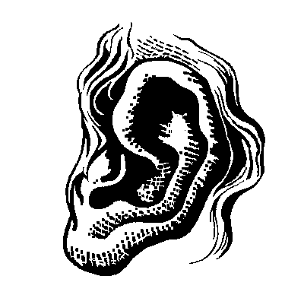
Recognizing a word
Input
Search for a match
dog
cat
cap
wolf
cat
tree
yarn
cat
claw
fur
hat
Notes:
Transition: what sorts of things affect lexical access? What does a model need to account for?

Slide 100
Recognizing a word
Input
Search for a match
dog
cap
wolf
cat
tree
yarn
cat
cat
claw
fur
hat
Notes:
Transition: what sorts of things affect lexical access? What does a model need to account for?

Slide 101
Recognizing a word
Select word
Retrieve lexical
information
Input
Search for a match
dog
cap
wolf
Cat
noun
Animal, pet,
Meows, furry,
Purrs, etc.
cat
tree
yarn
cat
cat
cat
claw
fur
hat
Notes:
Transition: what sorts of things affect lexical access? What does a model need to account for?

Slide 102
The
man
hit
the
dog
with
the
leash.
S
NP
det
N
The
man

Slide 103
The
man
hit
the
dog
with
the
leash.
S
NP
VP
V
det
N
The
man
hit

Slide 104
The
man
hit
the
dog
with
the
leash.
S
NP
VP
V
NP
NP
det
N
det
N
The
man
hit
the
dog

Slide 105
The
man
hit
the
dog
with
the
leash.
S
NP
VP
V
NP
NP
PP
Modifier
det
N
det
N
The
man
hit
the
dog
with
the
leash

Slide 106
The
man
hit
the
dog
with
the
leash.
S
NP
VP
V
NP
PP
Instrument
NP
det
N
det
N
with
the
leash
The
man
hit
the
dog

Slide 107
The
man
hit
the
dog
with
the
leash.
How do we know which structure to build?

Slide 108
Memory and comprehension
Brief summary so far:
What is the role of syntax in comprehension?
Syntax is important for getting the right interpretation during on-line comprehension
Memory capacity may play an important role in determining what kinds of information we can use to comprehend sentences
What about memory for language over the longer term? What do we remember about sentences?
Syntax may not be too important later, we remember the meaning of sentences but not so much the form (syntax) of the sentence
Notes:
object relative sentences that contained verbs that either did or did not provide strong pragmatic cues as to which of the two potential actors in the sentence was the agent of a given verb:
Main verb constrained; embedded verb constrained: The robber that the fireman rescued stole the jewelry.
Main verb unconstrained; embedded verb constrained: The robber that the fireman rescued watched the program.
Main verb constrained; embedded verb unconstrained: The robber that the fireman detested stole the jewelry.
Main verb unconstrained; embedded verb unconstrained: The robber that the fireman detested watched the program.

Slide 109
Propositions
Good memory for meaning but not for form
How do we represent sentence meaning?
Propositions
Two or more concepts with a relationship between them
A mouse bit a cat
bit (mouse, cat)

Slide 110
Propositions
Good memory for meaning but not for form
How do we represent sentence meaning?
Propositions
Two or more concepts with a relationship between them
A mouse bit a cat
bit (mouse, cat)
Can represent this within a network framework

Slide 111
Meaning as Propositions
Propositions
A set of conceptual nodes connected by labeled pathways that expresses the meaning of a sentence
A mouse bit a cat
or
A cat was bitten by a mouse
mouse
agent
cat
patient
relation
bit

Slide 112
Deriving Propositions
More complex example:
Children who are slow eat bread that is cold
Slow children
Children eat bread
Bread is cold
Past
Eat
relation
subject
subject
relation
time
relation
Slow
Children
Bread
Cold

Slide 113
Evidence for Propositions
Memory better for sentences with fewer propositions
“The crowded passengers squirmed uncomfortably”
passengers crowded
passengers squirmed
passengers uncomfortable
Three propositions
“The horse stumbled and broke a leg”
horse stumbled
horse broke leg
Two propositions

Slide 114
Evidence for Propositions
Bransford & Franks, 1971
Constructed four-fact sentences, and broke them down into smaller sentences:
4 - The ants in the kitchen ate the sweet jelly that was on the table.
3 - The ants in the kitchen ate the sweet jelly
2 - The ants in the kitchen ate the jelly.
1 - The jelly was sweet.

Slide 115
Evidence for Propositions
Bransford & Franks, 1971
Study: Heard 1-, 2-, and 3-fact sentences only
Test: Heard 1-, 2-, 3-, 4-fact sentences (most of which were never presented)

Slide 116
Evidence for Propositions
Bransford & Franks, 1971
Results:
the more facts in the sentences, the more likely Ss would judge them as “old” and with higher confidence
Even if they hadn’t actually seen the sentence
Constructive Model: we integrate info from individual sentences in order to construct larger ideas
emphasizes the active nature of our cognitive processes

Slide 117
Alternative Representations
Propositions are symbolic
Problems:
The referential problem
The implementation problem
The lack of scientific productivity
The lack of a biological foundation
Alternative
Embodied representations (e.g., Barsalou; 1999; Glenberg, 1999)
Notes:
The referential problem:
Symbols are encapsulated: they only refer to other symbols, in a recursive network.
Symbols are not grounded to perceptual, motor, or emotional experience.
The implementation problem:
There is no fully automatic parser that is capable to translate a plain text into a propositional codes (or any other symbolic code)
Is this a temporary "technical" problem that will be solved sooner or later? or Is it a substantial problem for symbolists?
The lack of scientific productivity:
Symbolists do not feel interested in exploring meaning empirically, nor demonstrate their "psychological reality".
They seem more interested in demonstrating the formal sufficiency of symbols (e.g., computability), than producing testable hypotheses.
The lack of a biological foundation:
Symbolist theories have their roots in logic, philosophy, or computer sciences.
Symbolist theories are scarcely constrained by biological data (e.g., evolutionary), or neurological data.

Slide 118
Arguments against propositions
Propositions are symbolic and amodal
Referential problem:
Disconnected with outside world (symbols referring to other symbols)
Implementation problem:
Has been very difficult to develop a propositional parser
Lack of scientific productivity:
More work on what you can do with propositions than is there evidence of the psychological reality of propositions
Lack of a biological foundation:
How do biological (or neurological) data constrain propositions
Notes:
The referential problem:
Symbols are encapsulated: they only refer to other symbols, in a recursive network.
Symbols are not grounded to perceptual, motor, or emotional experience.
The implementation problem:
There is no fully automatic parser that is capable to translate a plain text into a propositional codes (or any other symbolic code)
Is this a temporary "technical" problem that will be solved sooner or later? or Is it a substantial problem for symbolists?
The lack of scientific productivity:
Symbolists do not feel interested in exploring meaning empirically, nor demonstrate their "psychological reality".
They seem more interested in demonstrating the formal sufficiency of symbols (e.g., computability), than producing testable hypotheses.
The lack of a biological foundation:
Symbolist theories have their roots in logic, philosophy, or computer sciences.
Symbolist theories are scarcely constrained by biological data (e.g., evolutionary), or neurological data.

Slide 119
Embodiment in language
Embodied Representations
Perceptual and motor systems play a central role in language production and comprehension
Theoretical proposals from many disciplines
Linguistics: Lakoff, Langacker, Talmy
Neuroscience: Damasio, Edelman
Cognitive psychology: Barsalou, Gibbs, Glenberg, MacWhinney, Zwaan
Computer science: Steels, Feldman

Slide 120
Embodiment in language
Embodied Representations
Perceptual and motor systems play a central role in language production and comprehension
Words and sentences are usually grounded to perceptual, motoric, and emotional experiences.
In absence of immediate sensory-motor referents, words and sentences refer to mental models or simulations of experience
Simulation hypothesis
Simulation exploits some of the same neural structures activated during performance, perception, imagining, memory…
Language gives us enough information to simulate
Notes:
Brain activity
Comprehension and images
Concrete words
Action words activate motor representations
Words activate areas in the brain overlapping with those areas involved in perception and action.
Understanding texts describing spatial situations activates visuospatial representations.
Understanding concrete words activate visual representions of shape, orientation, etc.
Understanding texts describing actions and movements, activates motoric representations.
Understanding emotional texts activate emotional representations

Slide 121
Embodiment in language
Evidence for Embodied representations
Stanfied & Zwaan (2001)
Presented participants with sentences
John put the pencil in the cup.
John put the pencil in the drawer
See a picture and ask “does this describe what you read about?”
Reults: faster at saying horizontal pencil with drawer and vertical pencil with cup
Notes:
Brain activity
Comprehension and images
Concrete words
Action words activate motor representations
Words activate areas in the brain overlapping with those areas involved in perception and action.
Understanding texts describing spatial situations activates visuospatial representations.
Understanding concrete words activate visual representions of shape, orientation, etc.
Understanding texts describing actions and movements, activates motoric representations.
Understanding emotional texts activate emotional representations

Slide 122
Embodiment in language
Evidence for Embodied Representations
Zwaan et al (2004)
Presented participants with a sentence
A: The pitcher hurled the softball at you.
B: You hurled the softball at the pitcher.
See two pictures and ask “are these pictures the same object”
A
B
Reults: faster at saying ‘Yes’ when sentence matched the pictures (e.g., sentence A and pictures in A, if the ball is small and then gets big, it is coming towards you)
Notes:
Brain activity
Comprehension and images
Concrete words
Action words activate motor representations
Words activate areas in the brain overlapping with those areas involved in perception and action.
Understanding texts describing spatial situations activates visuospatial representations.
Understanding concrete words activate visual representions of shape, orientation, etc.
Understanding texts describing actions and movements, activates motoric representations.
Understanding emotional texts activate emotional representations

